Slide 1
Big Data Technologies
Chapter 3
Map Reduce Framework
Instructor: Suresh Pokharel

Slide 2
Map-reduce Basics
MapReduce is a processing technique and a program model for distributed computing.
The MapReduce algorithm contains two important tasks, namely Map and Reduce.
Map takes a set of data and converts it into another set of data, where individual elements are broken down into tuples (key/value pairs).
Secondly, reduce task, which takes the output from a map as an input and combines those data tuples into a smaller set of tuples.
As the sequence of the name MapReduce implies, the reduce task is always performed after the map job.

Slide 3
Map-reduce Basics
The major advantage of MapReduce is that it is easy to scale data processing over multiple computing nodes.
Under the MapReduce model, the data processing primitives are called mappers and reducers.
Decomposing a data processing application into mappers and reducers is sometimes nontrivial. But, once we write an application in the MapReduce form, scaling the application to run over hundreds, thousands, or even tens of thousands of machines in a cluster is merely a configuration change.
This simple scalability is what has attracted many programmers to use the MapReduce model.

Slide 4
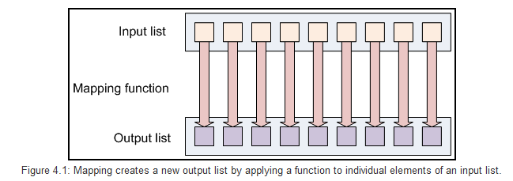
Map-reduce Basics
Mapping Lists
The first phase of a Map-Reduce program is called mapping.
A list of data elements are provided, one at a time, to a function called the Mapper, which transforms each element individually to an output data element.

Slide 5
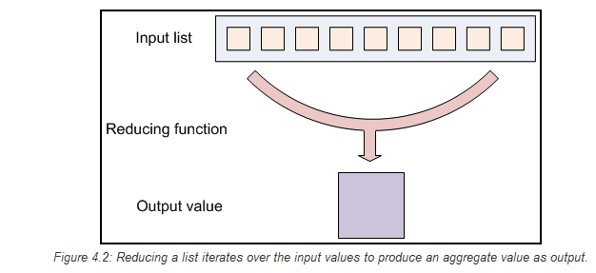
Map-reduce Basics
Reducing List
Reducing lets you aggregate values together.
A reducer function receives an iterator of input values from an input list.
It then combines these values together, returning a single output value.

Slide 6
Map-reduce Basics
MapReduce program executes in the following stages:
Map stage : The map or mapper’s job is to process the input data. Generally the input data is in the form of file or directory and is stored in the Hadoop file system (HDFS). The input file is passed to the mapper function line by line. The mapper processes the data and creates several small chunks of data.
Reduce stage : This stage is the combination of the Shuffle stage and the Reduce stage. The Reducer’s job is to process the data that comes from the mapper. After processing, it produces a new set of output, which will be stored in the HDFS.
Execution overview

Slide 7
Some Terminologies
PayLoad - Applications implement the Map and the Reduce functions, and form the core of the job.
Mapper - Mapper maps the input key/value pairs to a set of intermediate key/value pair.
NamedNode - Node that manages the Hadoop Distributed File System (HDFS).
DataNode - Node where data is presented in advance before any processing takes place.
MasterNode - Node where JobTracker runs and which accepts job requests from clients.
SlaveNode - Node where Map and Reduce program runs.
JobTracker - Schedules jobs and tracks the assign jobs to Task tracker.
Task Tracker - Tracks the task and reports status to JobTracker.
Job - A program is an execution of a Mapper and Reducer across a dataset.
Task - An execution of a Mapper or a Reducer on a slice of data.
Task Attempt - A particular instance of an attempt to execute a task on a SlaveNode.

Slide 8
Example (word count)
map(String key, String value):
// key: document name
// value: document contents
for each word w in value:
EmitIntermediate(w, "1");
reduce(String key, Iterator values):
// key: a word
// values: a list of counts
int result = 0;
for each v in values:
result += ParseInt(v);
Emit(AsString(result));

Slide 9
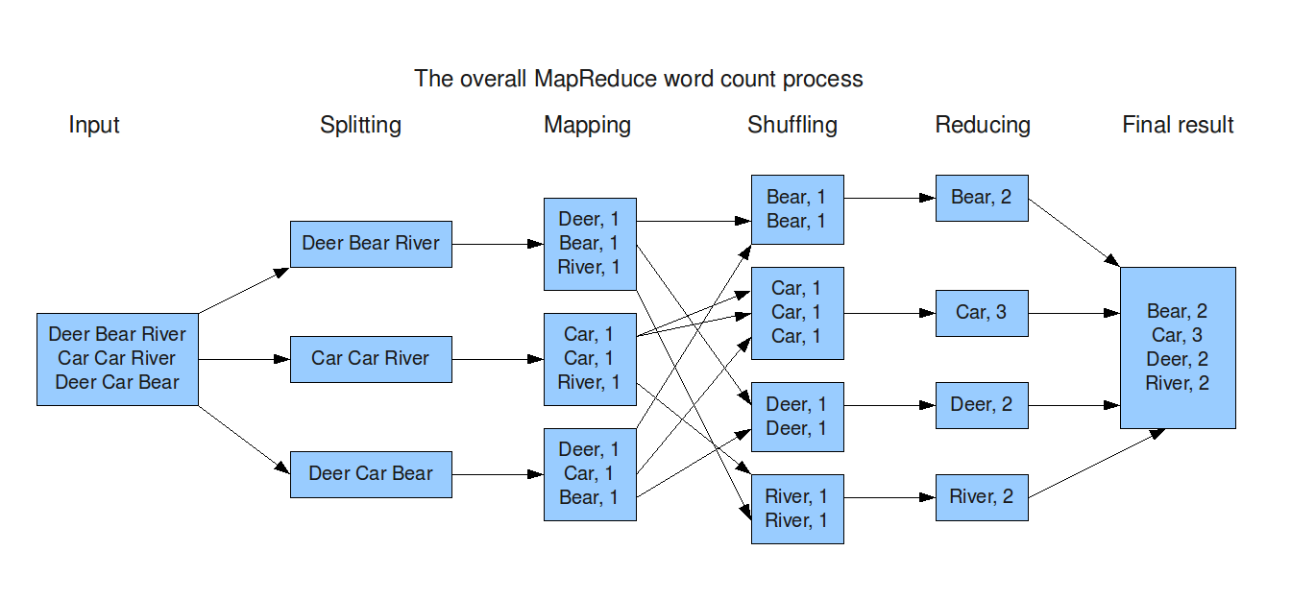
Example (word count)

Slide 10
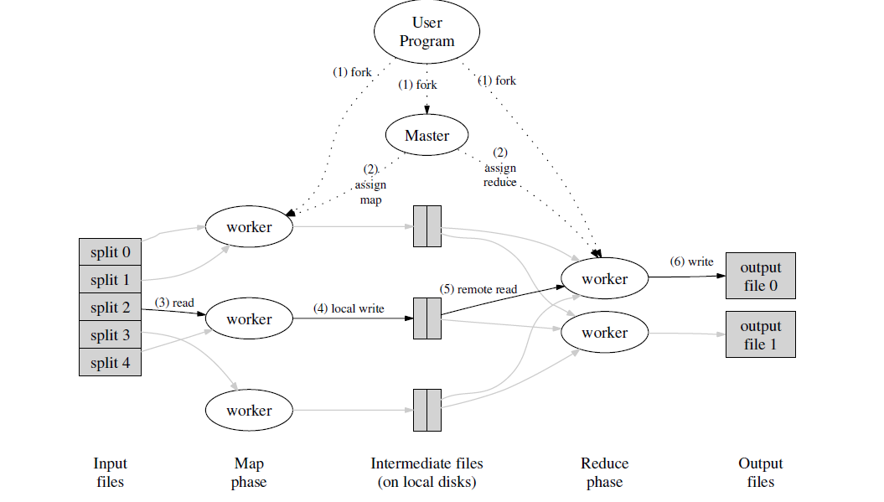
Execution overview

Slide 11
Example (Removing Duplicates)
We basically would like to implement the distinct operator: the desired output should contain all of the input values, but values that appear multiple times in input, should appear only once in output. We use the value itself as the map output key; the reducer associated with a specific key, can then return a single output.
Map: For each input value v, output the key-value pair (v, v)
Shuffle: For each key v produced by any of the Map tasks, there will be one or more key-value pairs (v,v). Then, for key v, the shuffle will produce (v, [v, v, ..., v]) and present this as input to a reducer.
Reduce: the reducer for key v turns (v, [v, v, ..., v]) into v, so it produces exactly one output v for this key v.
Note that the way we defined the reducer is slightly imprecise as we should define pairs as output. This is a small technicality that also depends on the MapReduce implementation we are using: in Hadoop for example, we can have the reducer return the pair (v, null) or (null, v) to obtain the same result.

Slide 12


Slide 13
References
http://www.tutorialspoint.com/hadoop/hadoop_mapreduce.htm
http://had00b.blogspot.com/2013/08/mapreduce-gentle-introduction.html

